Slide 1

Lariat Rent-A-Car Business Strategies
Capstone 1
Saulo Sanchez

Slide 2
Business objectives
Decreasing cost or increasing revenue by focusing on which cars made the most money, and the cars that did not make any profit.

Slide 3
How did we do?
2018 Financial Analysis

Slide 4
Review options for decreasing cost and increasing revenue
Getting rid of 3 least profitable cars
Replacing them with the top 3 most profitable cars

Slide 5
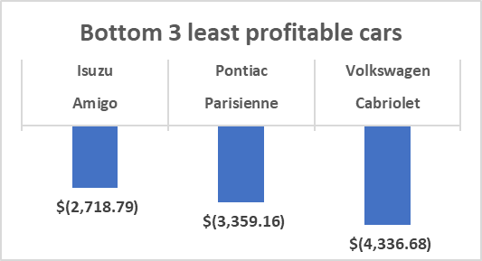
Strategy 1: Decreasing cost by getting rid of 3 least profitable cars

Slide 6
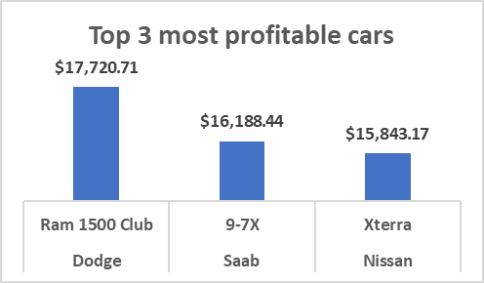
Strategy 2: increasing revenue by Replacing bottom 3 least profitable cars with the top 3 most profitable cars

Slide 7
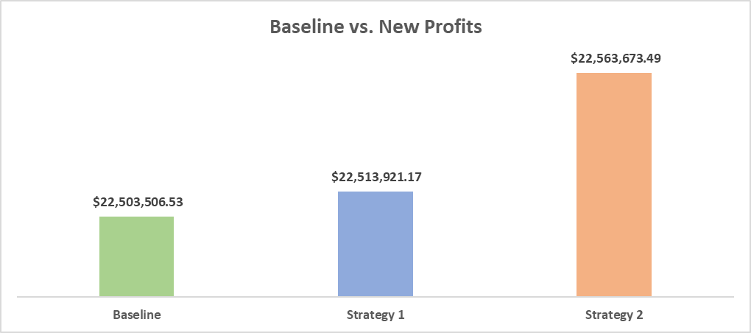
Profits Baseline vs. Strategies

Slide 8
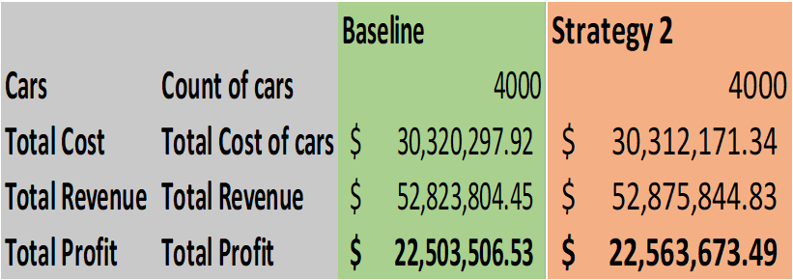
Recommendations & call to action
Replacing the bottom 3 least profitable cars with top 3, will impact profit considerably, as we can see below.

Slide 9
Questions?

Slide 10
Thank You!

